Slide 1
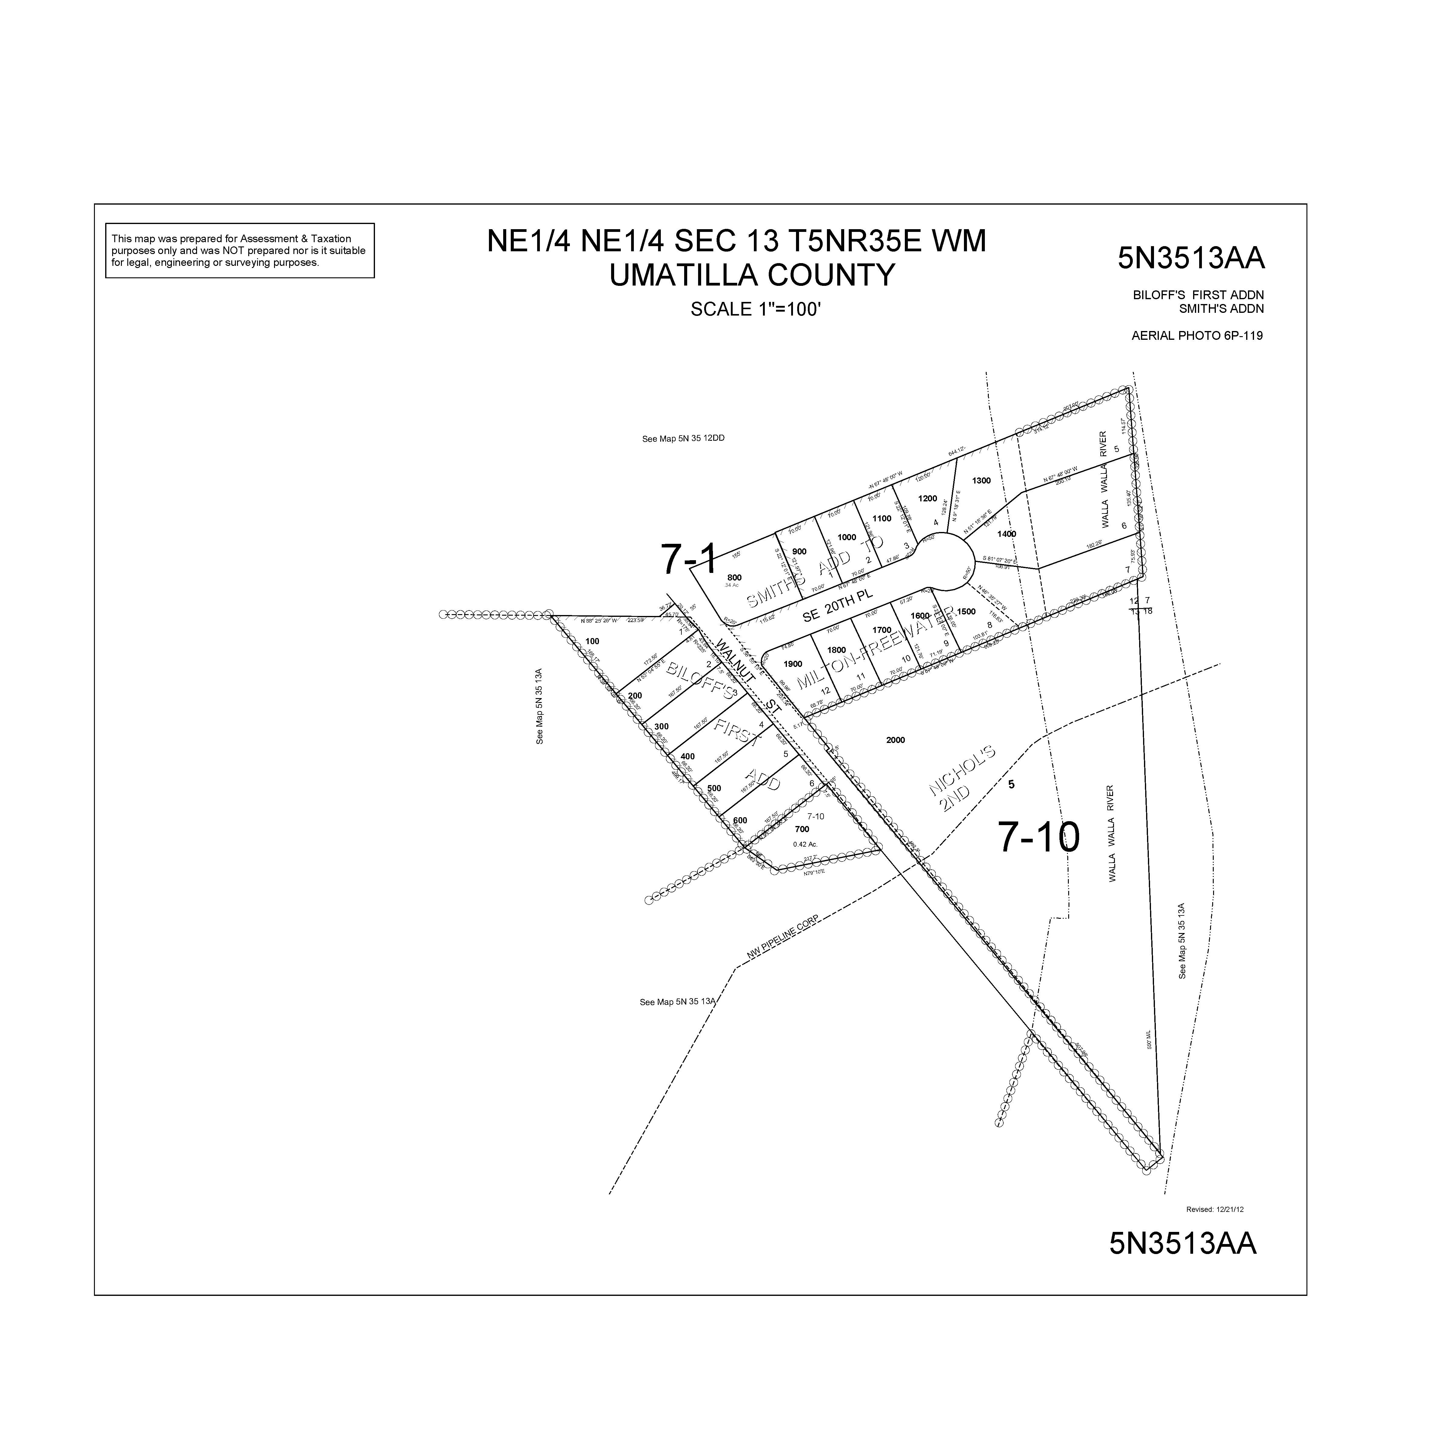
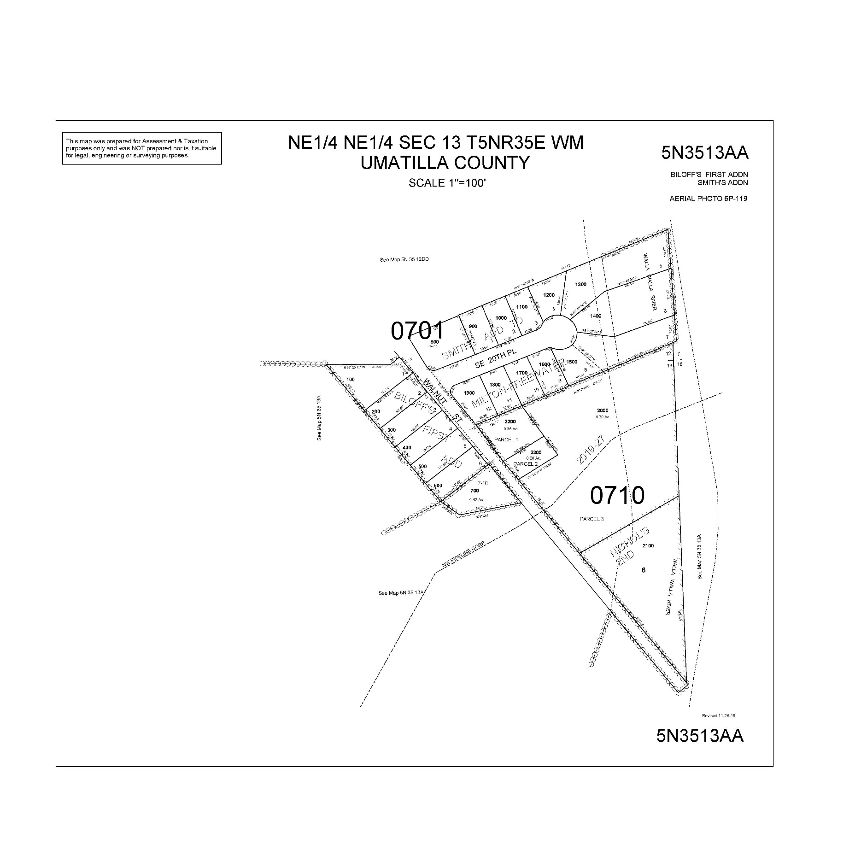
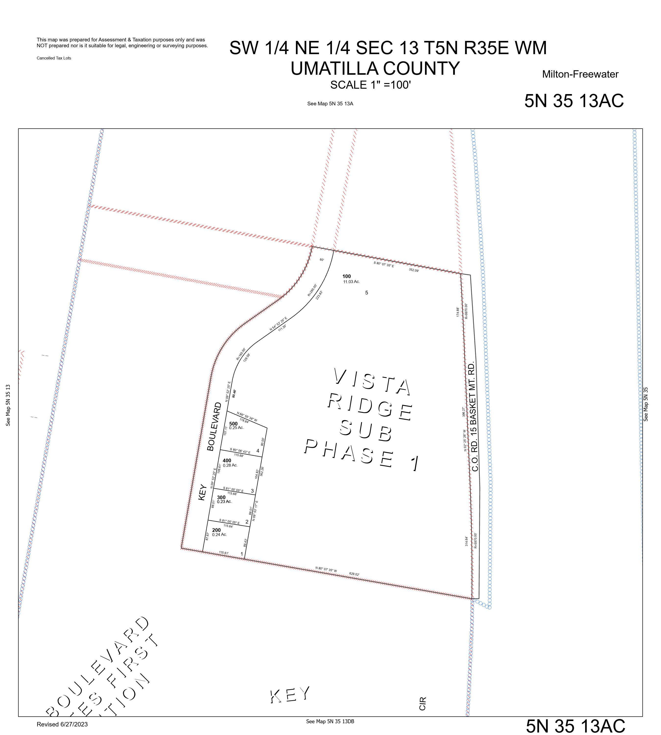
ALSO SEE SURVEYS 84-116-B, R-0118-B, 05-114-G
BOOK 2 PAGE 23
(NICHOLS SECOND ADDITION)
83-010-B
S-108-B
BOOK 13 PAGE 53
(SMITH’S ADDITION)
83-010-B
BOOK 12 PAGE 28
(BILOFF’S FIRST ADDITION)
BOOK 2 PAGE 23
(NICHOLS SECOND ADDITION)
PPLAT 2019-27

