Slide 1
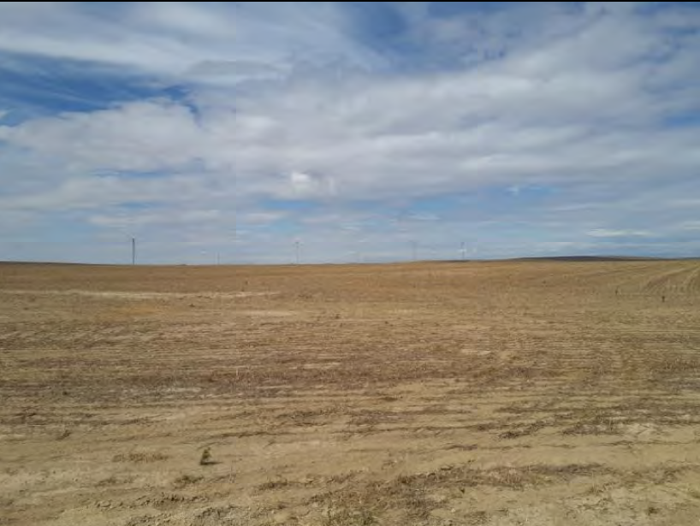

Fourmile Solar
Goal 3 Exception Request
Umatilla County Board Hearing – March 18, 2026
Comprehensive Plan Text Amendment #T-101-25

Slide 2
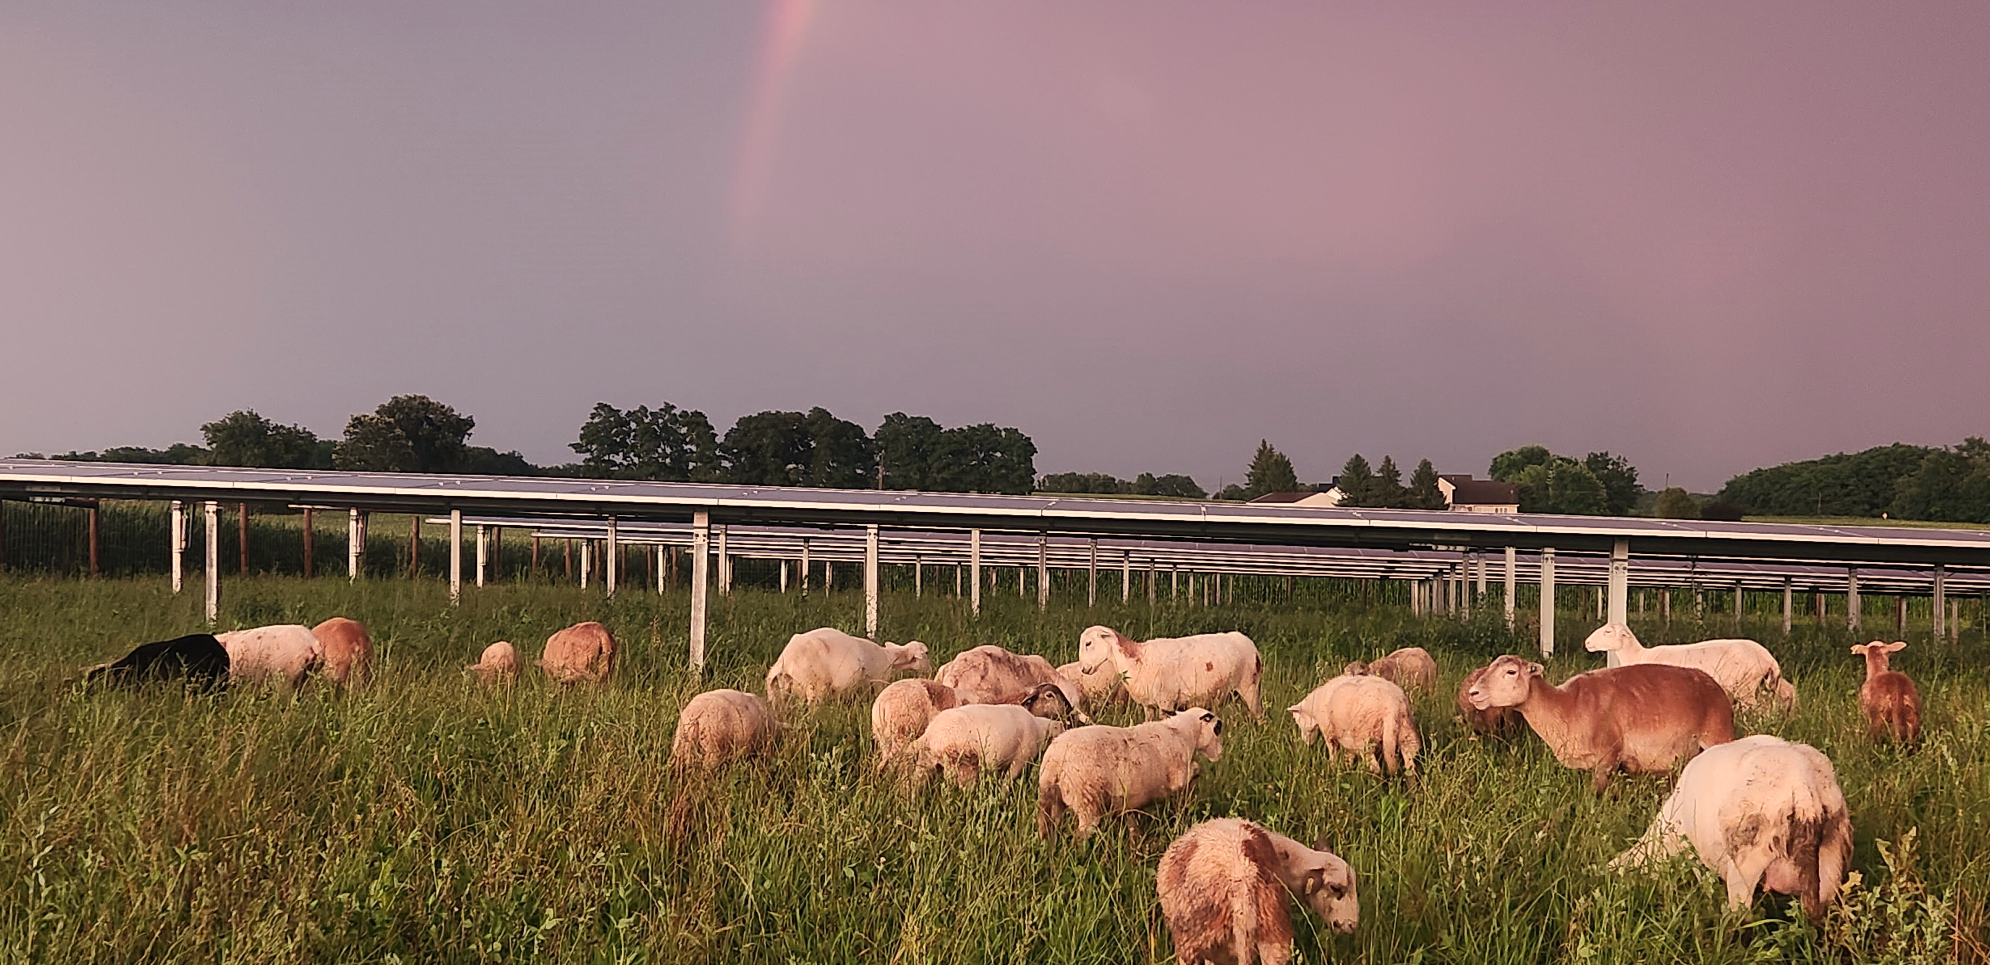
Agenda
Introduction
Project Overview
Request & Applicable Approval Criteria
Questions

Slide 3
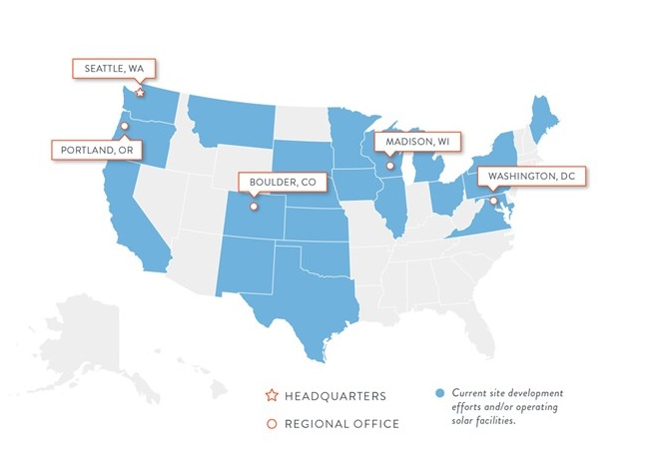
About Us
COMPANY
Washington-based independent developer of energy projects with offices in Seattle, Portland, Boulder, Madison, and Virginia.
Established in 2009, Public Benefit Corporation
130 Employees
PROJECTS
Our projects include community solar, distributed generation, and utility scale projects
1GW of Operational Projects
TEAM
Tanner Gillespie – Associate Director, Development
Bobby Wenger – Associate, Development

Slide 4
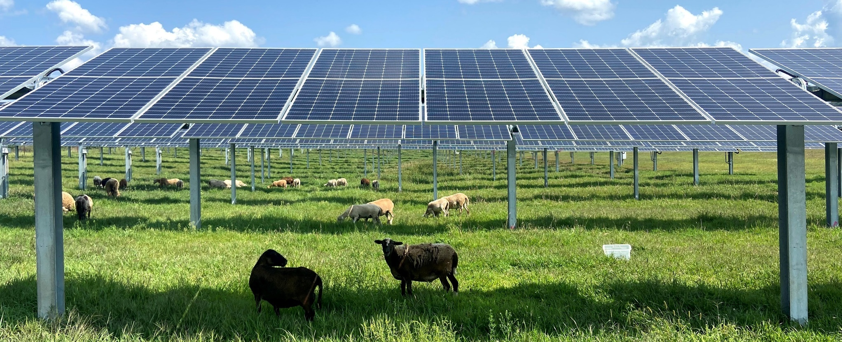
OneEnergy Siting Approach
Landowner
Partner
Existing Infrastructure
Suitable Site

Slide 5
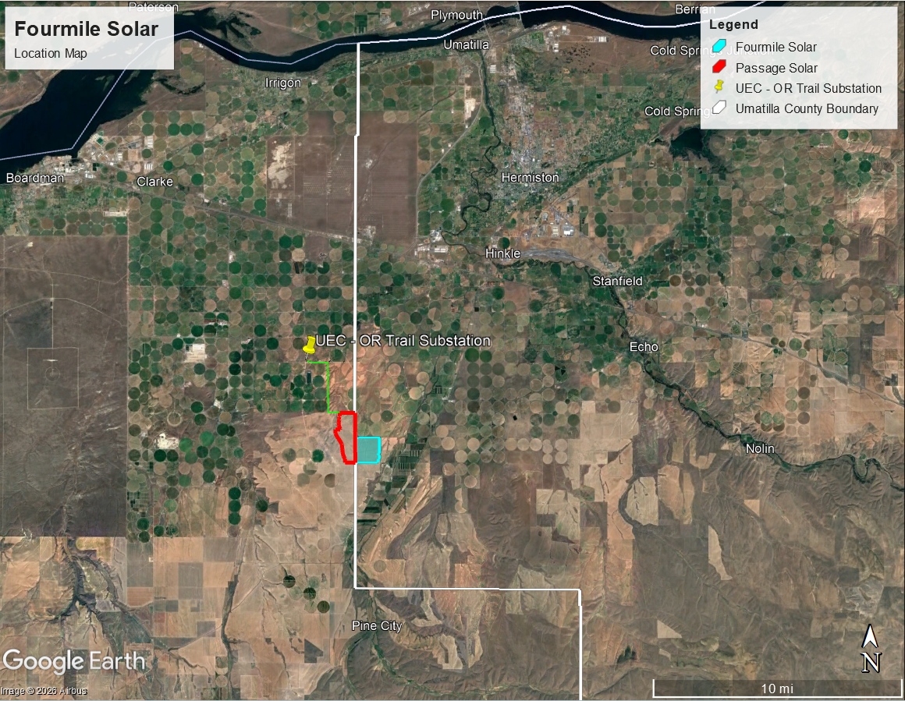
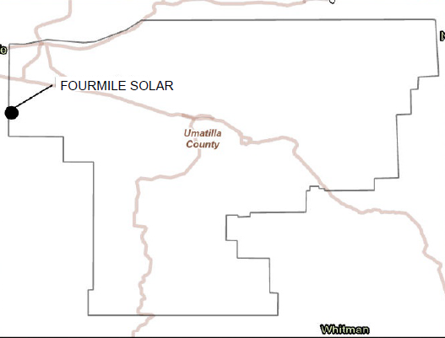
Project Location
Fourmile Solar
Passage Solar

Slide 6
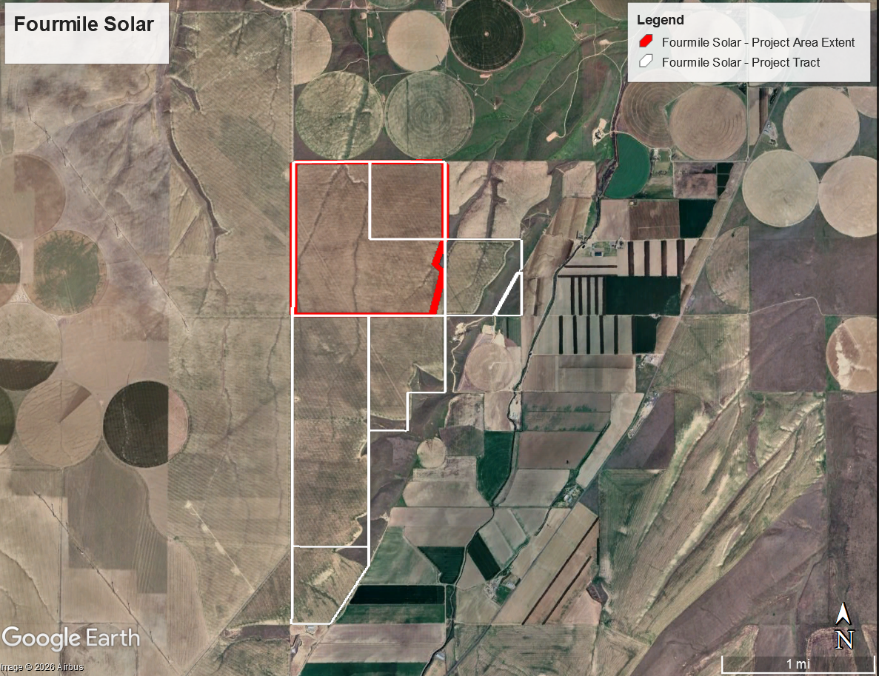
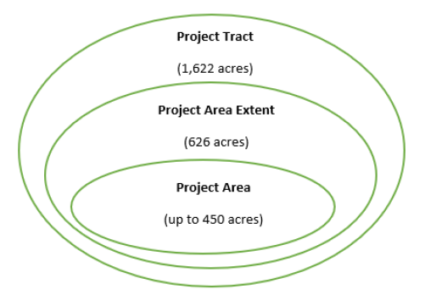
Project Micrositing
Project Area Extent: Micrositing boundary within which the Project Area will be wholly encompassed.
Project Area: Permanent footprint of the project.

Slide 7
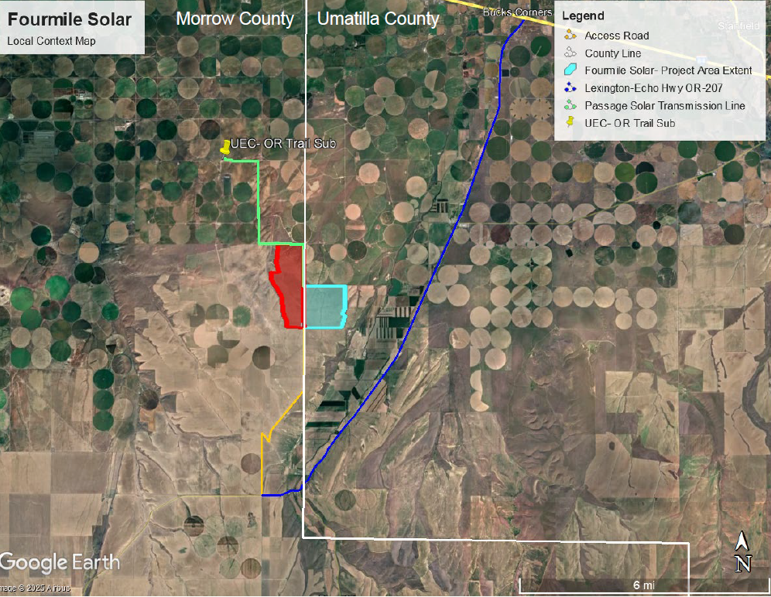
Site Selection
Micrositing Considerations:
Identified following robust Alternatives Analysis
High solar energy resource
Proximity to transmission infrastructure
Flat, unirrigated land
Minimal Environmental Impact
No impacts to high value habitat
No impacts to irrigated soils
No impacts to wetlands or floodplains
Minimal impacts to soils
Continued farming on remaining tract
Landowner actively cultivates 12,000+ acres.
Morrow County
Umatilla County

Slide 8
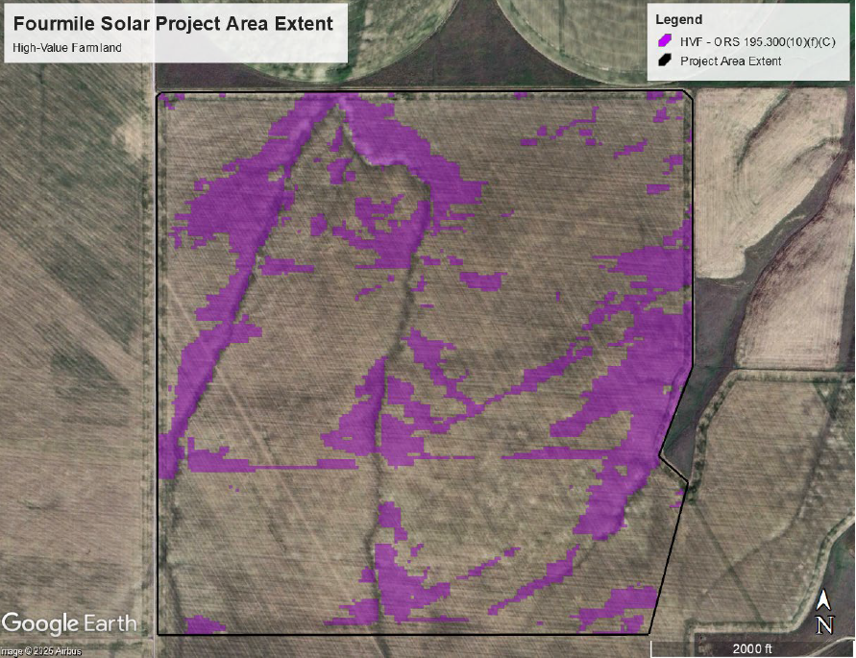
Site Selection
Soil Characteristics:
No prime, unique, Class 1 or 2 soils in Project Area Extent
No soils within area of water use permit or irrigation or improvement district in Project Area Extent
Limited American Viticulture Area (AVA) high-value farmland (HVF) soils (shown in purple)
Majority of soils are comprised of Class 3 & 4 soils

Slide 9
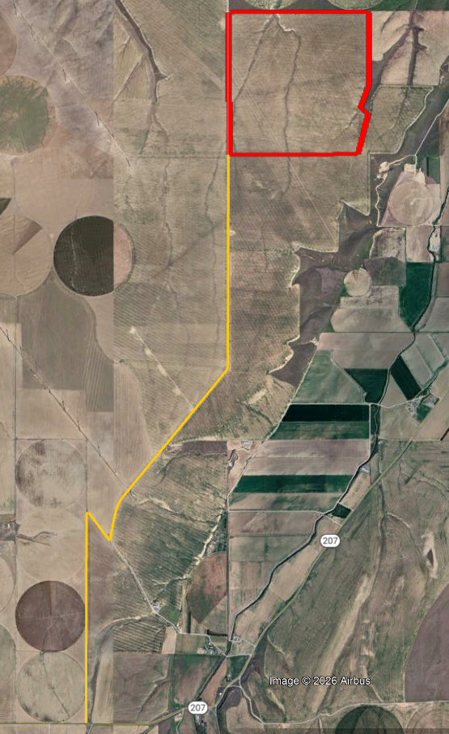
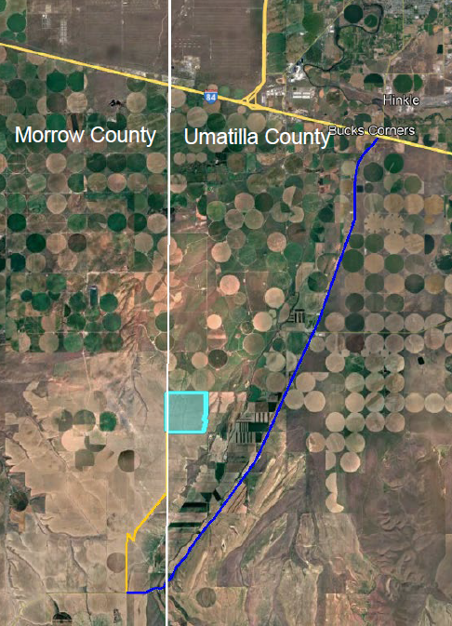
Site Access
Access
Via private farm road, south of the Project Area, off Hwy 207 at intersection located in Morrow County.
Transportation Route
Route enters Umatilla County on I-84 then exits to OR-207, heads south and crosses into Morrow County before turning onto a private access road.
Private Farm Road
4.75 miles
OR 207 (ODOT)

Slide 10
PROJECT OVERVIEW – Details
Location | Umatilla County, approx. 11 miles southwest of Echo, OR
Landowners | Timothy and Shannon Rust Living Trust The Shannon Rust Share of the Frank and LaVonne Mader Living Trust Clarkston Development Company
Site Control | Long-term land lease agreement Signed site control: April 28, 2023
Zoning | Exclusive Farm Use
Land Use | Cultivated for dryland crops and agricultural operations
Utility Interconnection | Umatilla Electric Cooperative and Bonneville Power Administration
System Size | 90 MW AC Solar + optional Battery Storage - Up to 450 acres
System Type | Single-axis tracking ground-mounted solar PV
Projected Annual Output | ~140,000 megawatt hours (MWh) per year Enough to power approximately 12,000 average homes
Estimated Online Date | Q3 2028

Slide 11
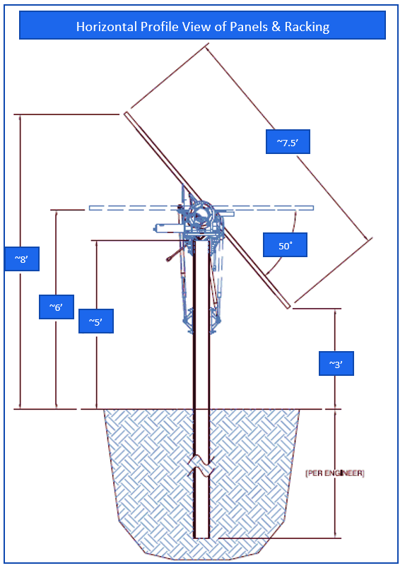
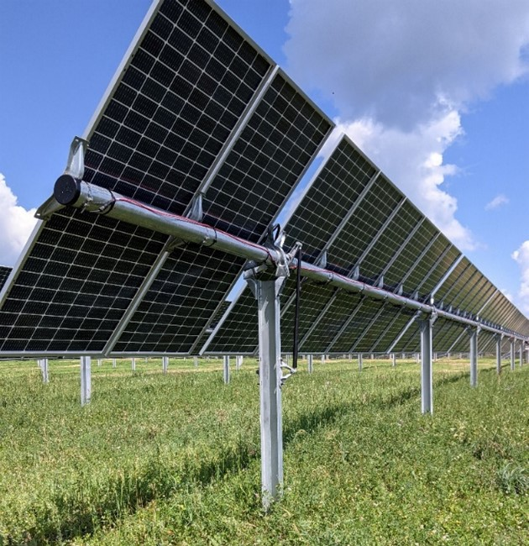
Project Components – Solar Panels
Panels
Photovoltaic cells made of crystalline silicon convert sunlight to electricity
Anti-reflective coating on the glass exterior reduces energy lost to reflection
Racking
Steel racking system supported by steel posts
Tracking technology maximizes energy production by following the sun throughout the day

Slide 12
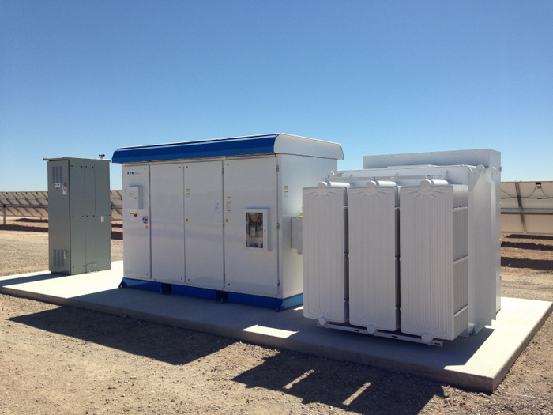
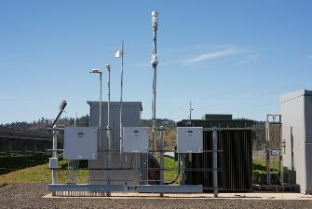
Project Components – Electrical Equipment
Inverters
Inverters convert solar energy into electricity for grid
Inverters work with step-up transformers to increase voltage
Interconnection Infrastructure
Main step-up transformer to utility voltage
Control house with protective equipment
Located on secure cement pad, restricted public access

Slide 13
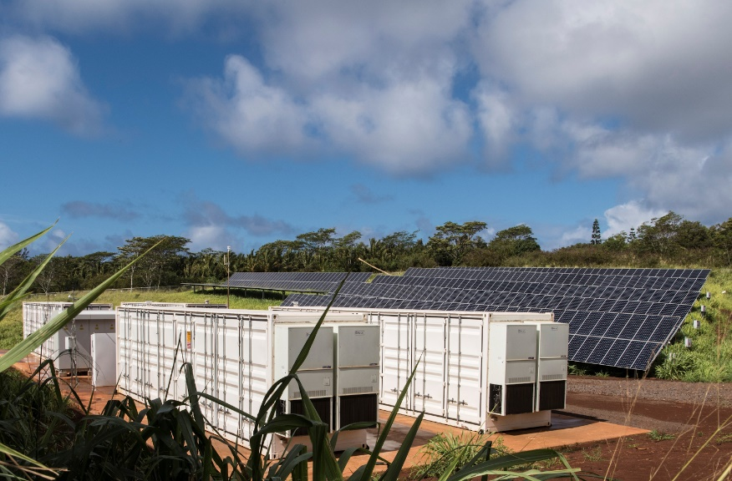
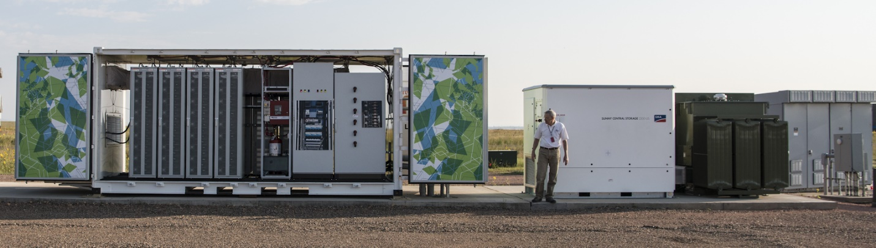
Project Components – Battery Storage
Battery Energy Storage System
Equipment to store and deliver electricity to grid
National Fire Protection Association (NFPA) Standards
Oregon Fire Code

Slide 14
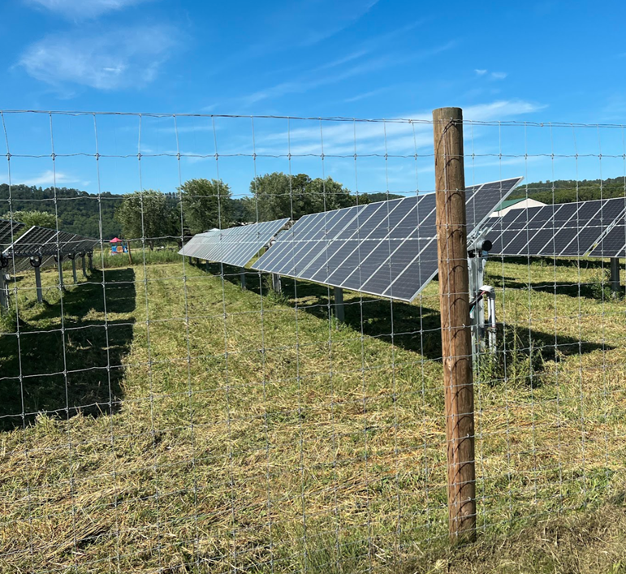
Project Components – Fencing and Internal Roads
Fencing
A security fence around the perimeter
Fence height and gates in accordance with County and emergency services access needs.
Internal Roads
Low impact maintenance roads
Fire vehicle turnarounds
Access roads 20’ wide per Oregon Fire Code

Slide 15
Project Studies
Phase I ESA | Complete
Land Surveys | Complete - ALTA Survey, LiDAR Survey , Geotechnical Survey
Wetland Delineation | Complete - no wetlands on-site
Wildlife and Habitat Survey | Complete - no critical habitat on-site, category 6 habitat
Cultural Survey | Complete – Surveys conducted with support from tribes
Soils Analysis | Complete - No Class I or II Soils and limited HVF impacts
Glare Analysis | Complete - No glare impacts identified
FAA Analysis | Complete
DoD Consultation | Complete
ODOT Consultation | Complete (Access Easement secured via private landowner)
Interconnection | Complete – Interconnection Agreement Executed

Slide 16
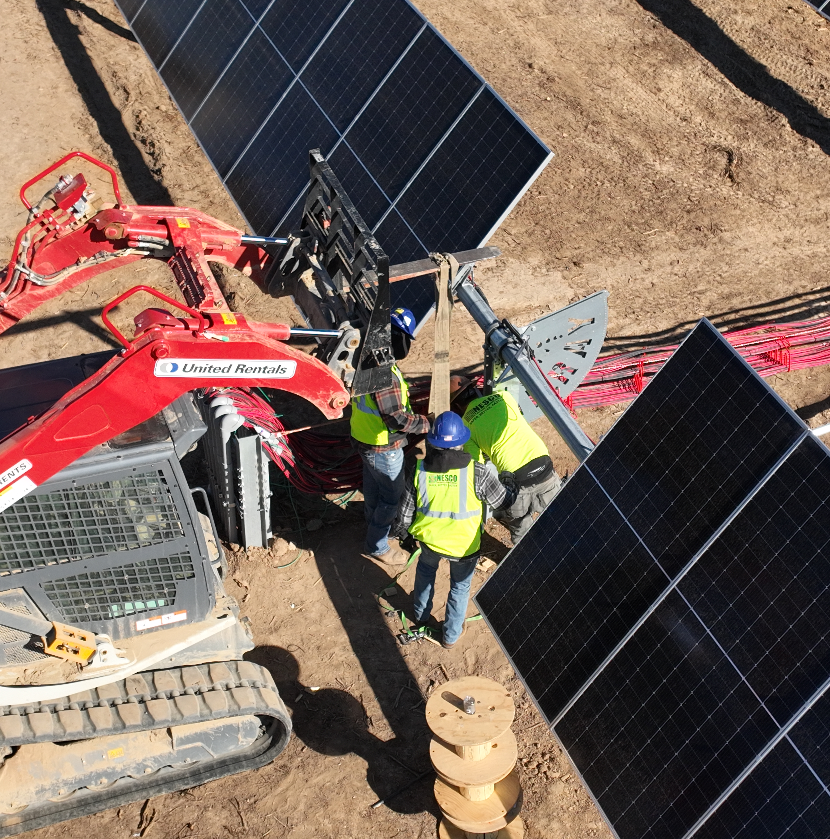
Project Development Timeline
1
2
3
2023-2027
Development and Permitting
2027 – 2028
Construction
2028+
Mechanical Completion and Begin Operation
Remote monitoring, ongoing on-site maintenance with active vegetation management
Conduct environmental and interconnection studies; soliciting public feedback; obtain local land use approval
9 to 18-month construction period; establish vegetation; reach mechanical completion and commence operations

Slide 17
Applicant’s Request – Approval of Goal 3 Exception
Applicant requests the Board approve a Goal 3 Exception to allow the construction, operation, and retirement of a solar photovoltaic power generation facility, including accessory components, on up to 450 acres of arable land. The facility requires a Goal 3 exception because it will exceed 12 acres of HVF and 20 acres of arable land.
The Planning Commission approved the related Conditional Use Permit for the Project on January 22, 2026, subject to 7 precedent conditions and 21 subsequent conditions.

Slide 18
Goal 3 Exception Approval Criteria - ORS 197.732 and OAR 660-004
Four-Prong Test for Goal 3 Exception
1. Reasons supporting temporary removal of up to 450 acres from agricultural production [p 17-29]:
Rural Industrial Use Reason (solar resource, locational dependency)
Nearby electrical infrastructure
Shared transmission line
High solar resource
Large, flat contiguous tract
Requirements of Other Goals Justify the Exception
County’s Comp Plan Goals and Policies
Goal 5 - Encourage development of alternatives sources of energy.
Goal 9 - Encourage diversification within existing and potential resource-based industries.
Goal 13 - Encourage rehabilitation/weatherization of older structures and the utilization of locally feasible renewable energy resources through use of tax and permit incentives.

Slide 19
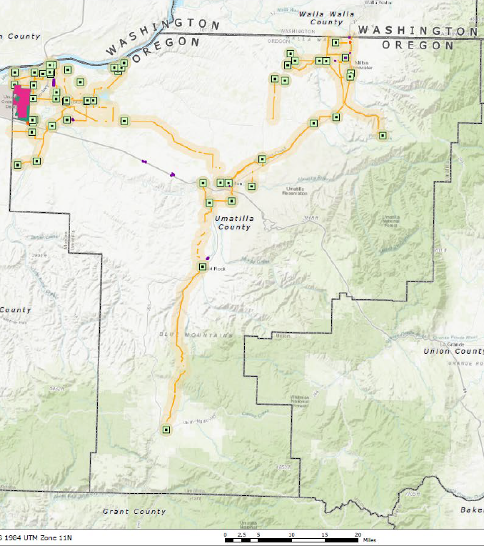
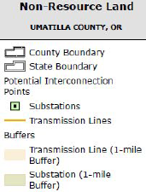

Goal 3 Exception Approval Criteria (cont’d)
2. Alternatives Analysis [p 29-32]
Defined siting criteria
Areas not requiring a goal exception cannot accommodate the project
No sites that meet the Project’s defined siting criteria that would not require a new goal exception

Slide 20
Goal 3 Exception Approval Criteria (cont’d)
3. Long-term Environmental, Economic, Social and Energy (ESEE) Consequences [p 32-36]
Adverse impacts are not expected, and any impact will not rise to the level of significant
4. Proposed Use is Compatible with Adjacent Uses [p 36-37]
Landowner will continue to cultivate their surrounding farmland
→ Proposed Mitigation via Vegetation and Weed Management Plan
Project is planning to utilize sheep grazing for vegetation management
Enabling the land to contribute to the agricultural economy during operations
Land remains agriculturally and economically productive while supporting clean energy
Proposed mitigation is captured in Precedent Condition 4 and Subsequent Condition 12.

Slide 21

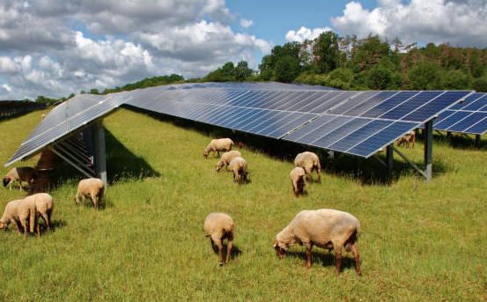
Operation and Maintenance
Project Life
Expected 35 years
Minimal on-site maintenance
Remotely monitored
Routine, as-needed maintenance
Active vegetation management - Project plans to use sheep grazing for vegetation management under Letter of Intent with Krebs Solar Grazing, LLC
Decommissioning
Decommissioning Plan (Precedent Condition 7)
Plan requires site be restored to pre-conditions or better
Project will post financial assurance for 100% of the estimated decommissioning cost prior to construction

Slide 22
CUP Conditions
The Planning Commission approved the CUP subject to 7 precedent conditions (PC) and 21 subsequent conditions (SC). Conditions ensure that commitments in the application are being fulfilled during construction and operations.
Examples:
PC 4. Obtain approval from Weed Supervisor for final Vegetation and Weed Management Plan.
PC 5. Soil Compaction Relief and Soil Erosion Control Plan incorporated into CUP.
PC 7. Secure decommissioning bond for retirement of the project, naming landowner and County as bond obligees; requires 5-year updates to accommodate changes in performance costs and inflation.
SC 2. Obtain all local, state, and federal permits and approvals including NPDES 1200-C stormwater permit.
SC 4. Requires construction best practices for equipment, machinery, spills, fire risk, noise.
SC 11. Requires reseeding of disturbed areas and adherence to Vegetation and Weed Management Plan.
SC 16/17. Comply with SHPO requirements for IDP, continue working with CTUIR.

Slide 23
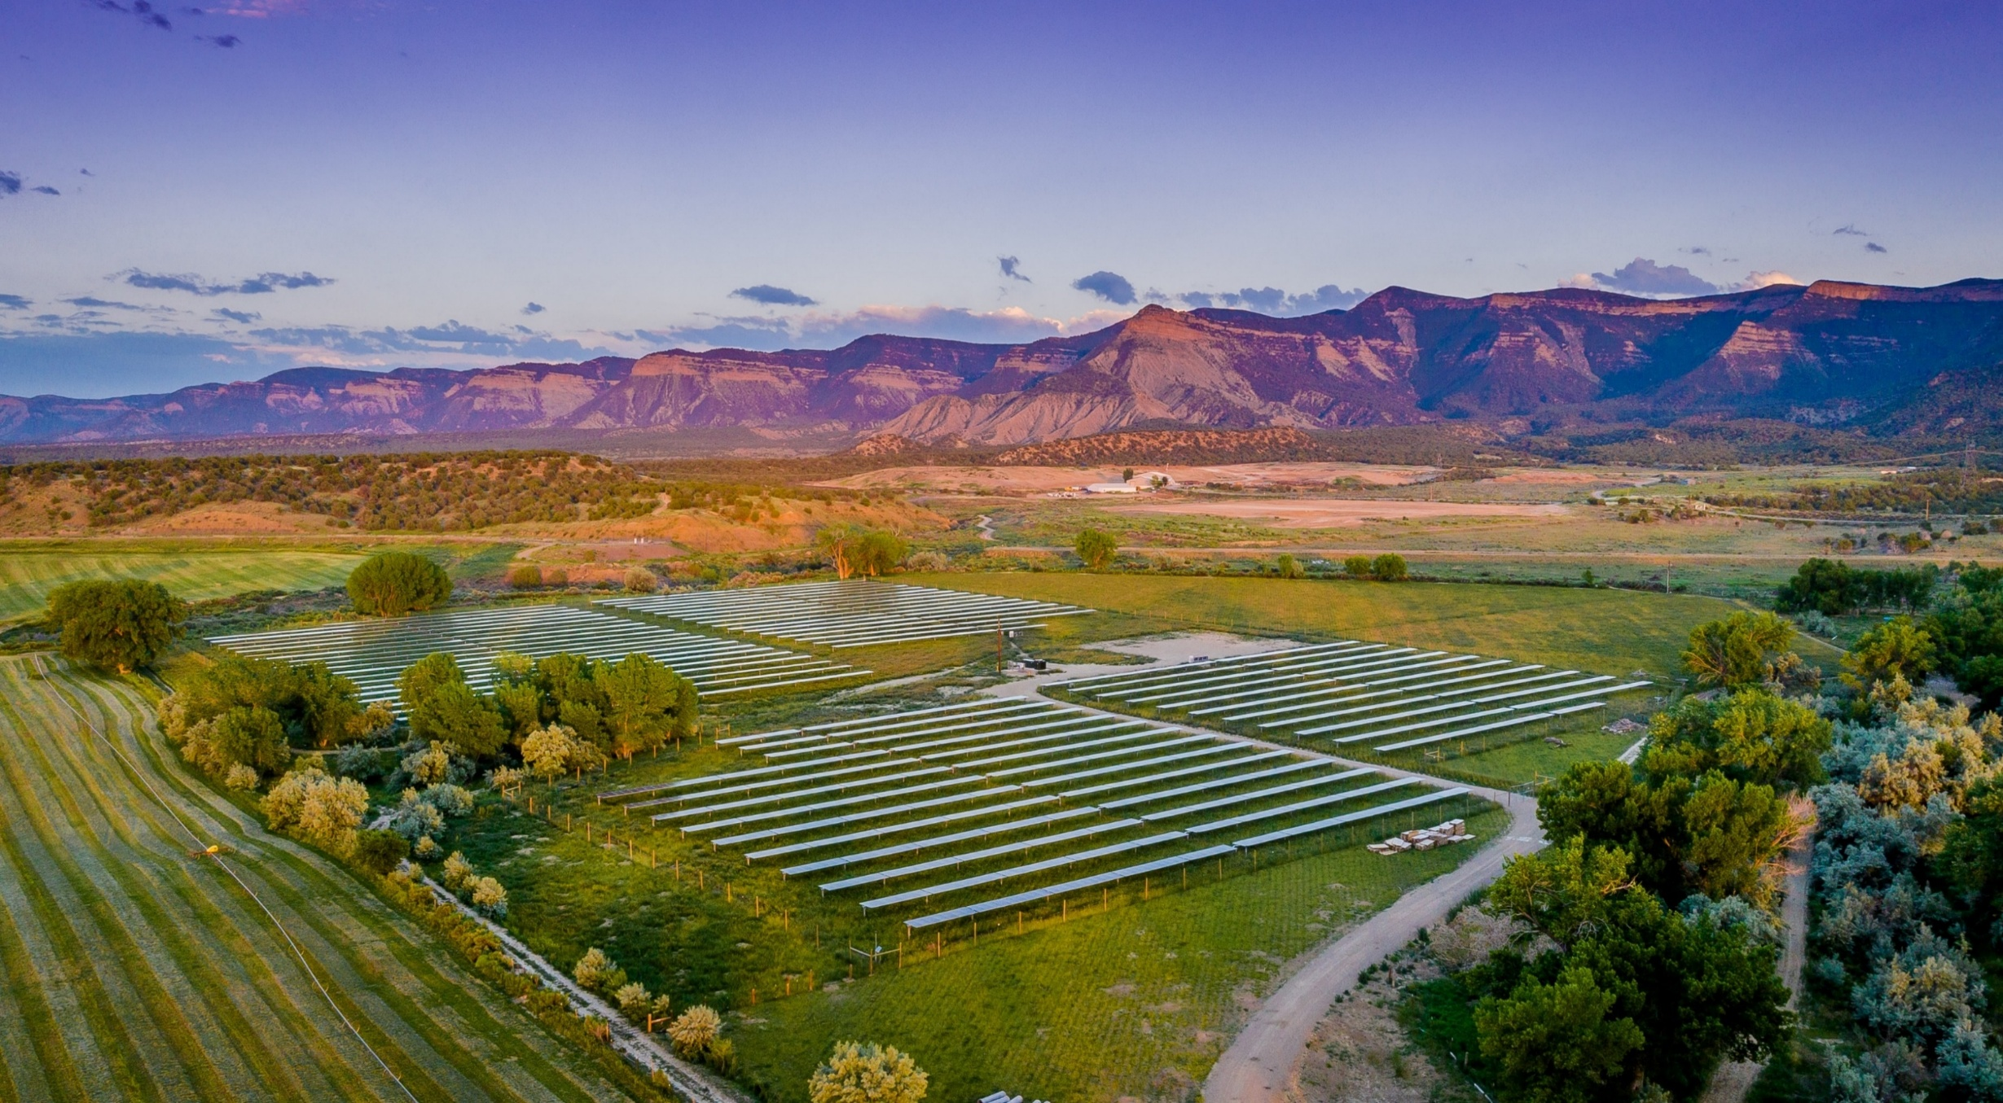
Questions?
Applicant respectfully request that the Board approve the proposed Goal 3 exception consistent with Staff’s Recommended Findings attached to Staff’s Board Memo, dated March 4, 2026.

